Slide 1
Case Study: Implementation of the Municipal Reference Model using IBM Rational System Architect
Roy Wiseman
Chief Information Officer (CIO), Region of Peel
Roy.Wiseman@peelregion.ca SIS-1703A
Notes:
The Municipal Reference Model (MRM) has been adopted by municipalities across Canada as a framework for describing and optimizing municipal government services. Until now, this framework has been applied by individual municipalities to describe their programs, services, and related characteristics (service output, outcome, client, target group, target group need, service value, performance targets, etc.) This session describes how, as municipalities developed a need to collaborate, share, and compare their individual service inventories, the Municipal Information Systems Association (MISA/ASIM Canada) partnered with IBM to develop and implement a solution, built around IBM Rational System Architect. This session highlights how this solution has been piloted with a small number of municipalities and is now ready for general release to MISA members.

Slide 2
Agenda
Introduction to MISA Municipal Reference Model (MRM)
Municipal Context and Challenges
MRM Basic Concepts
MRM History
Programs, Services and Processes: Viewing Government from the Outside-In (as our clients see us)
MRM Solution Components
Meta-Model, Reference Model, Municipal Instances, Tooling and Analytics
MRM Use Cases
Strategic Planning, Budgeting, Business Architecture, Performance Measurement, Program and Service Reviews, IT Planning, Solutions Development
MRM Implementation using IBM Software
Rational System Architect, Rational Publishing Engine, Lotus Quickr, FocalPoint
Next steps – making the business architecture actionable

Slide 3






Governments are facing unprecedented challenges
Reduced Revenues
Shifts from Operational to Strategic IT
Globalization
Surging demand for services
Differentiation
Develop Strategic Plans
Environmental Disasters
Policy Changes and Regulatory Mandates
Develop and Deliver Solutions for Outcomes
Govern for the Future
Aging Infrastructure
Economic Downturn
Continual Service Innovation
IT Saturation
Transparency, Regulatory Compliance
Governments need a better way to successfully respond to these challenges
3
Notes:
3
We live in a time of extreme challenges and we have extraordinary problems to solve. Not the least of which are mentioned on this slide. As Government organizations charged with serving citizens, you face challenges to effectively delivering those services to your people.
Demographics are changing – in many countries we’re seeing large populations of people growing older and requiring new services from health and human services organizations; we are also seeing changing demands based on an influx of immigrants, these forces married with lingering high levels of unemployment leaves government organizations struggling to keep up with the demand.
These rising citizen needs and the stress they are putting on government seem to illustrate the need for changes in other places. For instance, we see that aging infrastructure and growing IT portfolios hinder the ability to respond quickly to these changing citizen needs. We also live in a time of technological proliferation. Almost daily we become more connected and reliant on the ability to access information and to put our hands on what we need, when we need it. Many governments have gov 2.0 initiatives underway to help address the growing demand for services everywhere.
At the same time, we see an unprecedented call for government to be more transparent and demonstrate their accountability to their citizens. In the face of constant change – whether it is evolving policy, or new regulations, the public sector is in the midst of a new economic environment.
In 2010. IBM conducted a CEO Study. We found that CEO’s and leaders in the Public Sector agreed that the new economic environment is vastly different - it is substantially more volatile, much more uncertain, increasingly complex, and structurally different. Interestingly, they agreed and recognized an immense value in having an accessible vision and in defining priorities for their organization, and they agreed that the vision and priorities must be reflected at the IT level.
****** additional background ******
Globalization, transparency and interconnected, distributed value chains are key influencers motivating business to take another look at how they utilize EA and IT systems for business improvement
Globalization: what's driving customers, partners and suppliers, and your competition is coming from anywhere resulting in a much more dynamic and unpredictable landscape.
Growth drives complex, rapidly changing value chains
Differentiation for higher value leads to greater supplier dependencies
Transparency: regulatory compliancy and becoming more transparent in engaging with stakeholders as a way to demonstrate corporate citizenship differentiation providing trust needed to engage
Connections drive need for openness, confidence and trust
Regulations and audits formalize and govern contracts
Smarter Planet: smart connected markets as an ecosystem of participants in a value chain connected by the Web
Globally connected network of instrumented, interconnected, intelligent and adaptable market places.
Shift from Operational to Strategic IT: From business support functions to product and service differentiation; from automating business applications to supporting management and strategy
IT Saturation: As more business functions are automated with IT solutions, change in IT has a greater effect on the business.
This results in a need to have better IT agility and integration in order enable sustainable solutions.
Planning, delivery and governance across the enterprise helps maximize business effectiveness to “do the right things right”

Slide 4

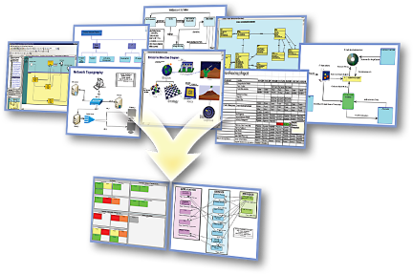
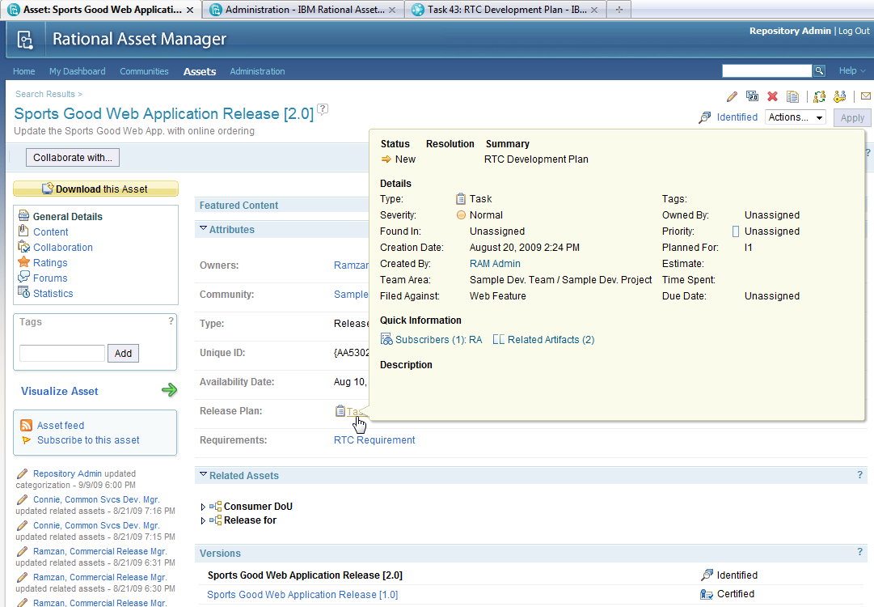















Addressing these challenges requires smarter planning, solution deployment, operations and business intelligence
Municipal Strategic Planning
Solution Design and Construction
Business Analytics
Asset Manager
Architect
Requirements Manager
Information Technology
Asset
Manager
Rational Software Architect
DOORS
Rational
Budgeting & Finance
Workforce/ HR
Mission Performance
Financial Performance
Jazz Platform
Operational Performance
ClearQuest
ClearCase
Rational Team Concert
Requirements
Professional
Quality Manager
Executive Management
Supply Chain
Operations/ Readiness
Services Delivery
Operational Systems
Program Execution
Smarter Cities Command and Control
Operations &
Planning
Situational Views
Simulation &
Investigation
Incident Mgmt
Trends & Analysis
Cross-domain
collaboration
Live Feeds
(Sensors & Subsystems)
Notes:
Municipal Strategic Planning
Utilize MRM as a starting point for an as-is Municipal Business Architecture, and as guideline for developing a to-be architecture based on best practices, principles, patterns and building blocks
Utilize strategic planning to assess different opportunities and solutions for closing the gap between current program and service outcomes, and those required by the community
Business Analytics for Municipal Government
Provides an effective means of analyzing operational information to enable effective management within the current global financial and economic environment to lay a foundation to build a better future
Enables collaboration within and across governments and target communities for policy development, planning, execution and management
Physical Meets Digital supports Smarter Cities Command and Control to automate and manage public service sub-systems using a collaborative environment that enables a city’s core systems to become smarter:
Collect, Filter and Manage the Right Kind of Data
Integrate, Analyze and Operationalize the Data
Optimize Citywide Systems to Achieve Desired Behavior
The Triton Platform can accelerate time-to-value for municipal IT solutions
What it is: “Triton” is a SWG asset from IBM providing an accelerated delivery of a SOA Foundation Infrastructure utilizing IBM Intellectual Property Assets including the Installation, Configuration and applicable implementation assets necessary to provide a fully functional SOA Foundation
What it does: Enable delivery excellence in delivering a SOA infrastructure by leveraging SOA Implementation Requirements, best practices, documentation, scripts, effectively utilizing harvested implementation assets
Why use it: To accelerate implementations (calendar and overall person/year effort) and lower risk, and leverage SOA best practices from across IBM globally.
Goal: Delivery of SOA Infrastructure Functionality (as Working Vehicle) vs, SOA “Do it yourself Kit” (Pile of Vehicle Parts & Assembly Instructions & Project Plan & Crossed Fingers & No assurance it will meet functional requirements and be delivered on time/on budget….if ever.)

Slide 5
The challenge of Government... Local, State, Provincial, Federal all have the same challenges…
Common threads in almost every study:
Defining our Services – Do we know what services we provide? Are they core to our business? What value are they offering? Are we offering the right Services?
Improving our Services – What is the cost of our services? How do we compare with other governments? Can we improve our efficiency, effectiveness and quality?
Service Levels – What is our current Service Level? How was it determined? What are the cost and service implications if we raise or lower Service Levels?
Service Accountability – Who is accountable for which Services? Is the allocation correct or does it need to be adjusted?
Alternate Service Delivery – Can we outsource, in-source, privatize or contract out all or a portion of our Services?
Service Operations – How do we deliver a service? Are there better ways? What can we learn from others?
The municipal sector will likely face a fiscal shortfall of between $56 billion and $83 billion from 2010-2012, driven by declining tax revenues, ongoing service demands and cuts in state revenues – National League of Cities (US), Dec. 2009

Slide 6
Objectives - Coherent Government by design
If we really want:
to move to a “whole of government” approach,
seamless, citizen-centred services,
legislation, regulations and policies designed rather than crafted,
alignment, integration, interoperability, etc. in our business systems,
to do more with less
We really need:
a consistent and more formal business design capability based on a common language and set of rules for using it to create better descriptions of what we want (e.g. more coherent ones). A pan-Canadian standard along these lines will enable any conceivable government line-of-business (and inter-collaborations thereof) to better:
interpret and clarify their missions, strategies, outcomes, etc.
accurately depict or map how they work (and how they can work together),
discover opportunities for business improvements,
support their planning and successful implementation

Slide 7
Municipal Reference Model MRM Concepts
7
Notes:
7

Slide 8
Municipal Reference Model
Brief History…..
1990: Joint Venture of 20+ Ontario municipalities to develop Municipal Reference Model and Engineering Database – initially as a data model
1992: MISA (Municipal Information Systems Association) awards RFP to develop and administer MRM to Chartwell IRM (acquired by KPMG in 2009)
1995-2000: MRM evolves from a data to a business model and is successfully implemented by Chartwell in several Canadian, US and overseas municipalities
Notes:
8
Background

Slide 9
MRM Municipal Users (c1998)
Shanghai
Warsaw
Notes:
9

Slide 10
Municipal Reference Model
Brief History…..
1990: Joint Venture of 20+ Ontario municipalities to develop Municipal Reference Model and Engineering Database – initially as a data model
1992: MISA (Municipal Information Systems Association) awards RFP to develop and administer MRM to Chartwell IRM (acquired by KPMG in 2009)
1995-2000: MRM evolves from a data to a business model and is successfully implemented by Chartwell in several Canadian, US and overseas municipalities
2000: MISA discontinues support of MRM for municipalities. Chartwell continues to promote with individual municipalities and other governments
2000-2008: MRM adopted and adapted by Province of Ontario (PSRM) and Government of Canada (GSRM);
2000-2008: MRM continues as a set of concepts which help define the business of government, but is essentially “paper-based”
Notes:
10
Background

Slide 11
Municipal Reference Model
Brief History (Cont’d)…..
2007: Based on renewed interest, MRMv2 Project undertaken by MISA/ASIM Canada to update and re-establish MRM at municipal level
2007: RFI issued to vendor community seeking MRM solution implementing MRM in modern modeling software
2008: MISA Selects IBM as partner to develop and implement solution
2008: IBM and MISA conduct IBM Business Value Assessment (IBVA) to confirm continued interest in and value of MRM. Strong interest expressed in numerous interviews by municipalities across Canada.
2009: IBM presents proof of concept, based on Rational Requisite Pro
2010: Pilot in Rational ReqPro proves unsuccessful – tools prove to be too complex for intended users (business users, not IT architects)
2010: IBM conducts architecture review: recommends different tool set, based on Rational System Architect.
2011: Successful pilot completed, based on System Architect. Product to be launched to initial set of municipalities in June
Notes:
11
Background

Slide 12
Municipal Reference Model Concepts: Organizing Framework
Government Reference Models Provide: A Common Language and Structure for Describing the business of Government from the outside-in – as our citizens see us.

Slide 13
MRM Concepts, Standard Vocabulary: Program
Program: a mandate to achieve goals and outcomes that address the needs of a target group. Programs are delivered through a collection of services that contribute to program goals.
Program Key Concepts:
Target Group
Need
Delivered through services
Outcome (a positive change in the level of need of the target group)
Public and Internal Programs
Sub-program

Slide 14
MRM Concepts, Standard Vocabulary: Service
Service Key Concepts:
Client (external to the organization providing the service)
Service output
Contribute to program outcomes
Complete/stand-alone
Sub-service
Service: provision of specific final outputs that satisfy client needs and contribute to program outcomes

Slide 15
MRM Concepts, Standard Vocabulary: Process
Process: a linked sequence of activities or tasks that use resources to produce outputs. Processes participate in a chain to produce service final outputs.
Process Key Concepts:
Interim outputs
Resources
Linked to deliver a service final output

Slide 16
MRM Concepts Illustrated: Public Health
Program | Public Health
Target Group | Municipal Residents and visitors
Need | Health
Outcome | Improved Health (How to measure? Can we define this more precisely?)
 | Service 1 | Service 2
Service | Food Premise Inspection | H1N1 Immunization
Service Output | Inspection Report (permission to continue operation) | Immunization
Direct Client | Food premise owner / operator | Resident (H1N1 at-risk) receiving immunization
Indirect Client | Food premise patron | Others in the community (residents and visitors)
Service Value | Reduced illness resulting from improper food preparation | Reduced illness resulting from fewer residents contracting H1N1
Process | Schedule inspection, conduct inspection, produce report, schedule follow-up | Establish clinic, prepare public communication, operate clinic, decommission clinic

Slide 17
MRM Concepts, Performance Measurement: Public Health
 | Program | Service | Process
 | Public Health | H1N1 Immunization | Clinic Operation
Effectiveness (relates to outcome) | Change in level of public health | Reduction in incidence of H1N1 | Set up on time, design effectiveness
Efficiency | Public Health cost/capita | Cost per delivered immunization (cost/output) | Operating cost/day
Quality (cf. to standard) | n/a | Immunizations to standard | # of operating issues – e.g. out of stock
Customer Satisfaction | Customer Satisfaction (reputation) | Service Satisfaction (Specific experience) | n/a

Slide 18
Municipal Reference Model MRM Solution Components
18
Notes:
18

Slide 19
The Municipal Reference Model (MRM)
Goal: A Tool (Product, Service) that will help municipal governments describe their vision, goals, objectives, programs, services and performance metrics
…in a standard way
…using precise definitions and concepts accepted and adopted by all stakeholders
…with tools and templates to help you create the descriptions of the municipality
…with user guides and training material to help create and use these descriptions for a range of municipal purposes
…with a repository where these descriptions can be saved
…repository pre-populated with a generic set of reusable service descriptions that may be provided to any municipality
…repository populated with specific descriptions (models) created by other municipalities
…with tools that allow for the analysis and comparison of such descriptions
…and with a collaboration space that allows ideas to be shared on how these tools are being used in participating municipalities
In short: A powerful Authoritative Service Catalog aligned to an Authoritative Meta Model that Municipalities can use and share
Notes:
MRM helps municipal governments describe their vision, goals, objectives, programs, services and performance metrics in a standard way, using precise definitions and concepts applicable to all stakeholders. Using the MRM, municipalities can create a model of their existing programs and services to understand and assess the ability of their organization units to produce outcomes that address constituent needs. The MRM can then be used and then explore the best practices and content that can help close the gap between available and desired services.

Slide 20
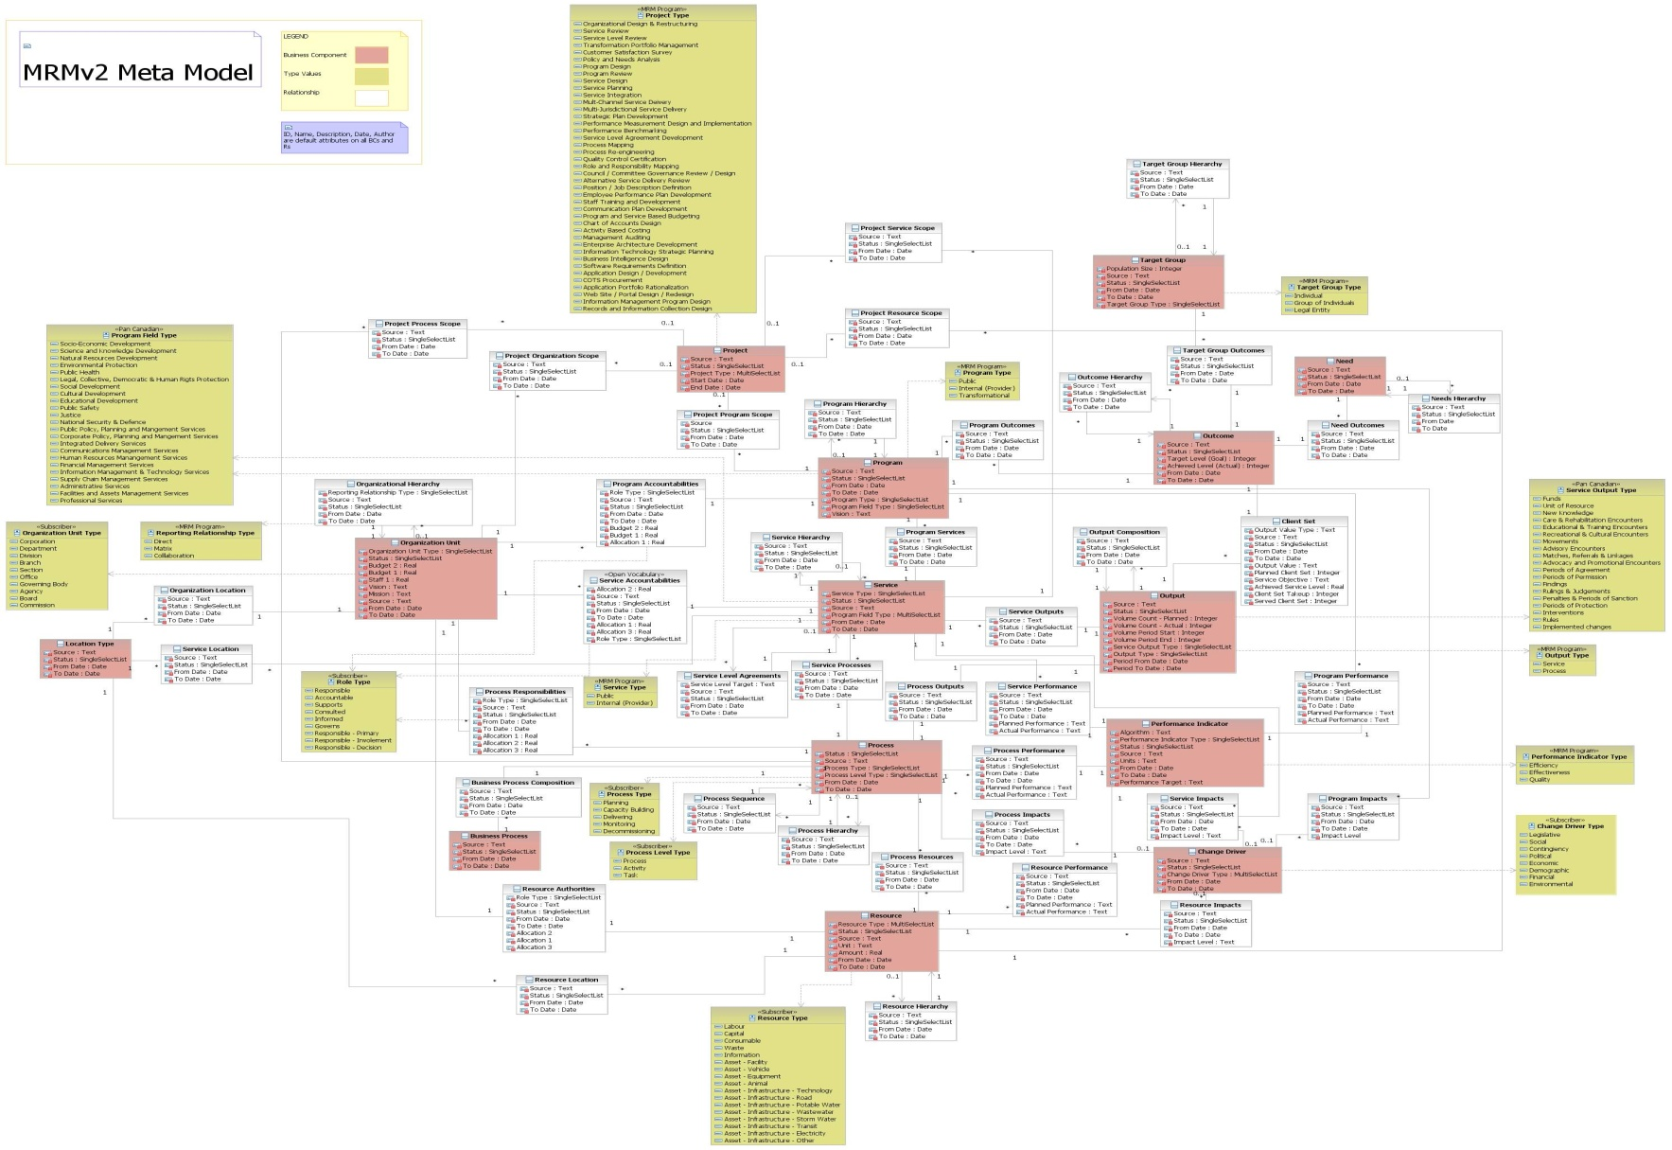
MRMv2 Meta-Model
CAUTION: DO NOT TRY TO READ THIS SLIDE!
Notes:
20
Caution reading this slide of the “meta model” where “pink” entities are core entities, “white entities: are intersection entities, and “dijon mustard yellow” entities are type tables.

Slide 21
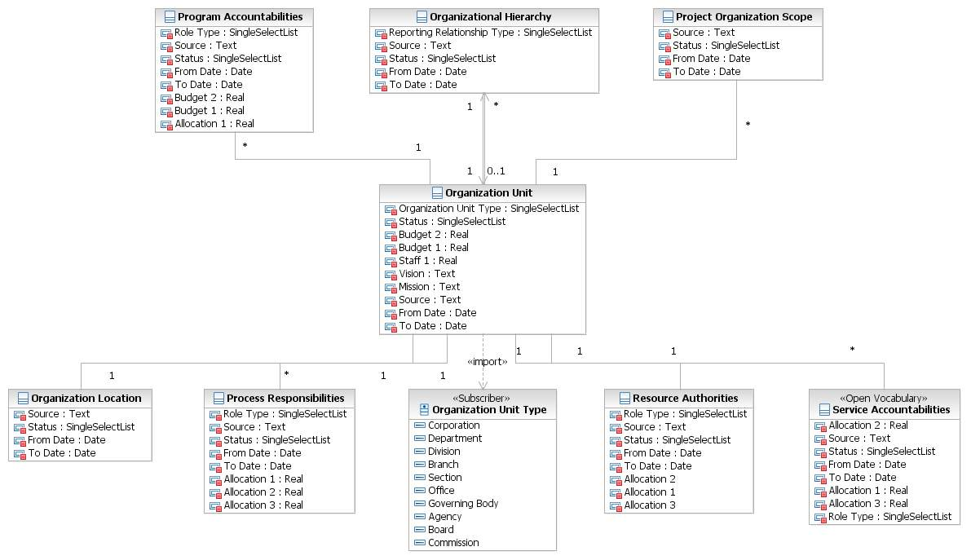
MRMv2 Meta-Model Extract
Notes:
21
A diagram illustrating the “meta model” element associated with an Organization Unit and how it is related to “first level” entities.

Slide 22
MRMv2 Selected Standard Vocabulary
Strategic Terms:
Vision
Mission
Core Values
Program Terms:
Program Goal
Program Need
Program Outcome
Program Target Group
Service Terms:
Service Output
Service Output Type
Process
Activity
Task
Client
Service Value (to client)
Performance Metric Terms:
Efficiency
Effectiveness
Quality
Role Terms:
Governance
Accountability
Responsibility
Authority
Activity
Enterprise Architecture Terms:
Mandate
Events
Cycles
Jurisdiction
Notes:
22

Slide 23
Standard Classification Schemes/Value Lists
Services
Clients
Outputs
The 19 GSRM Service Output Types
Supply capacity to act
(Units of) Resource
Funds
New Knowledge
Enhance capability to act
Care & Rehabilitation Encounters
Educational & Training Encounters
Movements
Recreational & Cultural Encounters
Facilitate & influence action
Advisory Encounters
Advocacy and Promotional Encounters
Matches, Referrals & Linkages
Periods of Agreement
Regulation action
Findings
Interventions
Penalties & Periods of Sanction
Periods of Permission
Periods of Protection
Rulings & Judgments
Core
Implemented changes
Rules (laws, regulations, policies, strategies, plans, designs, standards)
Source: Governments of Canada Strategic Reference Model (GSRM) specification
Notes:
23

Slide 24
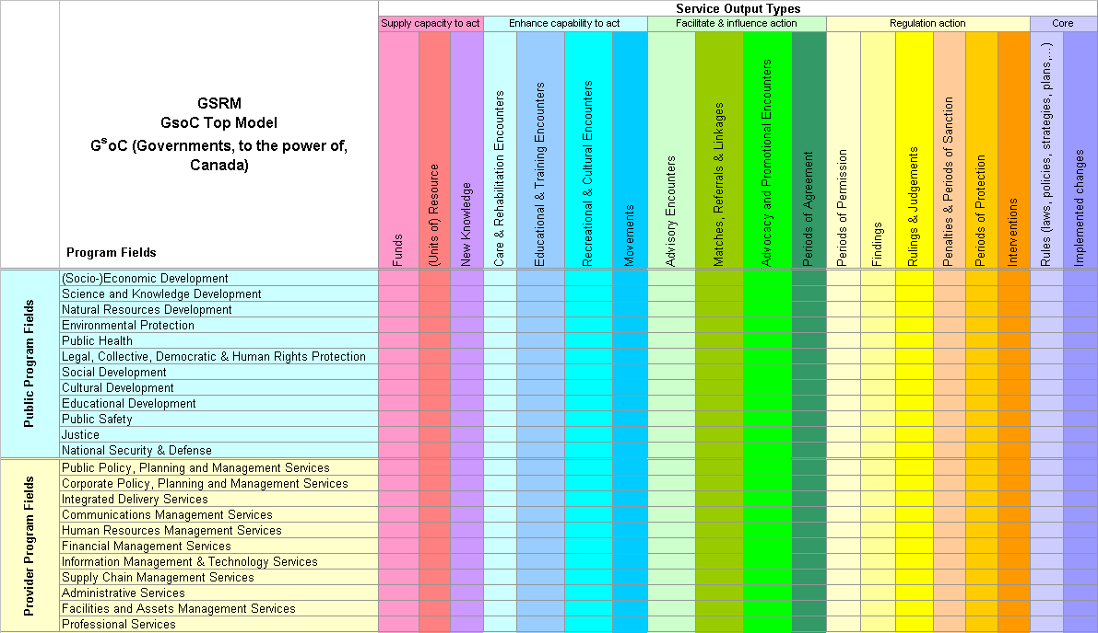
Standard Classification Schemes/Value Lists
GSRM Top Model: The 23 GSRM Program Fields
Source: Governments of Canada Strategic Reference Model (GSRM) specification
Notes:
24

Slide 25
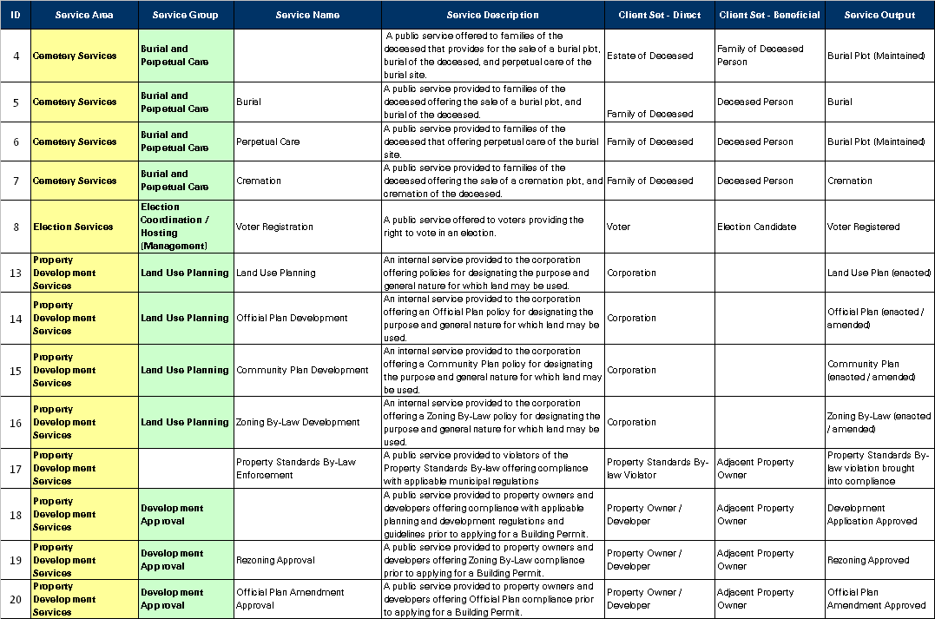
Standard Catalog of Programs and Services
About 150 high-level municipal services; Over 1,000 detail-level municipal services
Notes:
Sample Reference Model Services – Currently Under Development!

Slide 26
Standard Set of Program & Service Profiles
Emergency Care and Preventative Care
Service Type | Public
Accountable Unit | EMS
Purpose Statement | To provide excellent emergency and preventative care services to the people of Toronto through activities such as providing pre hospital emergency care, community medicine and inter facility patient transport services
Customer | EMS Patient Family / Relatives
Products / Types | Primary /Advanced Critical | Stand By special event Stand By Emergency
Output | EMS Emergency Care, Preventative Care, Facility Transport
Delivery Method | Upon Request
Service Level | 24/7/365
Efficiency | $ / Emergency Care & Preventative Care by type
Value Statement | improved health reduction in mortality | reduced pain reduced health care cost
Effectiveness | Response Time to Incident ( Road Response Time + Process Time ) Correct Resource response time according to Call priority (90% of the time) Percentage of Unit Hour Utilization | Cost of Unit Hour Production Mean Hospital Wait Time (Total Wait Time / # of Hospital Visit ) # of Public Access Defibrillators
Service Objective | To Improve the response time to life threatening calls (delta & echo) from 70% to 90% within 8:59 minutes and stated targets for alpha, bravo and charlie category type calls. To Reduce the in hospital time from 60 minutes to 45 minutes by 2008
Community Impact | Health Care Public Safety
Notes:
26

Slide 27
Putting it all Together: MRMv2 Components
MRM Reference Model
(i.e. Public Safety Program, Fire Rescue Service, etc.)
Customized “My Municipality’s” Model
MRM Meta-Model
(i.e. Shell Program, Shell Service, etc.)
Customized Municipality C Model
Best Practice Model
(i.e. AWWA Potable Water Supply Service, etc.)
Customized Municipality B Model
Customized Municipality A Model

Slide 28
Municipal Reference Model Use Cases
Notes:
28

Slide 29
Smarter Municipal Strategic Planning
Logical workflow
What applications do we have?
Where do we want to be in the future?
How are we going to get there?
Enterprise Inventory
Programs, Services
Supporting Resources
Future State Visioning
Architectural
Impact
Analysis and future state proposals
Transition Governance
Delivery
Planning &
Management
Portfolio management
Initial Gap Analysis
Municipal Architecture
Candidate Solutions
Business Motivation
Business Strategy
Transition Initiatives
Identify business influencers motivating change
Establish vision, goals and objectives
How: mission, strategy tactics
Who: impacted target groups and their needs
Set scope and time horizon
Instantiate Municipal Reference Model as to-be municipal architecture
Analyze current as-is municipal architecture
Analyze gap between delivered and desired outcomes to meet target group needs
Determine target group needs and required outcomes
Determine services required to produce outcomes
Organize into administrating programs
Determine accountable organizational units
Determine business strategy
Mission, strategy, tactics
Governing business policies and rules
Potential impact
Organize change initiatives into candidate projects
Specify how to realize tactics consistent with policies and rules
Supporting the achievement of goals and objectives
Motivated by policies and outcomes (not business stakeholders and profit)
Assess candidate projects against strategic objectives, ability to achieve required outcomes, risks, costs, time to value
Plan project roadmaps to determine project duration, milestones

Slide 30
Toronto: Linking Strategy to Budget
Notes:
30

Slide 31

Toronto: Program and Service Budget
Service Budgets with Service Profiles
Program Budgets with Service Allocations
2007 Operating Budget
Transportation Program
Handi-Transit Service Budget:
Service Objective: Achieve 95% Supply of Demand
Service Output: Handi-Transit Trip
Service Client: Handi-Transit Rider
2005 2006
Trips Demanded 101,356 102,000
Trips Supplied 67,668 78,000
% Supplied of Demand 67% 76%
Gross Cost / Trip $7.08 $7.21
Service Fee $1.00 $2.00
Net Cost / Trip $5.35 $5.18
---------------------------------------------------
Budget $361,697 $404,000
2007 Operating Budget
Program Budget:
Public Safety $2.3 Billion
Public Health $1.8 Billion
Transportation $1.1 Billion
Economic Development $0.2 Billion
Environmental Protection $0.3 Billion
Leisure, Arts and Culture $0.3 Billion
Property Development $0.1 Billion
-------------------------------------------------
TOTAL $6.1 Billion
2007 Operating Budget
Program Budget:
Public Safety $2.3 Billion
Public Health $1.8 Billion
Transportation $1.1 Billion
Economic Development $0.2 Billion
Environmental Protection $0.3 Billion
Leisure, Arts and Culture $0.3 Billion
Property Development $0.1 Billion
-------------------------------------------------
TOTAL $6.1 Billion
2007 Operating Budget
Program Budget:
Public Safety $2.3 Billion
Public Health $1.8 Billion
Transportation $1.1 Billion
Economic Development $0.2 Billion
Environmental Protection $0.3 Billion
Leisure, Arts and Culture $0.3 Billion
Property Development $0.1 Billion
-------------------------------------------------
TOTAL $6.1 Billion
2007 Operating Budget
Program Budget:
Public Safety $2.3 Billion
Public Health $1.8 Billion
Transportation $1.1 Billion
Economic Development $0.2 Billion
Environmental Protection $0.3 Billion
Leisure, Arts and Culture $0.3 Billion
Property Development $0.1 Billion
-------------------------------------------------
TOTAL $6.1 Billion
2007 Operating Budget
Program Budget:
Public Safety $2.3 Billion
Public Health $1.8 Billion
Transportation $1.1 Billion
Economic Development $0.2 Billion
Environmental Protection $0.3 Billion
Leisure, Arts and Culture $0.3 Billion
Property Development $0.1 Billion
-------------------------------------------------
TOTAL $6.1 Billion
2007 Operating Budget
Public Safety Program Service Budget:
Fire Rescue $75.1 Million
Police Intervention $92.8 Million
Criminal Investigation $38.1 Million
Building Permission $9.6 Million
Fire Prevention Education $5.1 Million
Crime Prevention Education $5.3 Million
Animal Control $4.1 Million
-------------------------------------------------
TOTAL $2.3 Billion
Notes:
31

Slide 32
Toronto
Enterprise Architecture
Accounting Services
(Program)
Payment Processing
Financial Reporting & Control
Management & Service Delivery
Process Profiles
Corporate A/P
A/R
Corporate Banking
Notes:
32

Slide 33
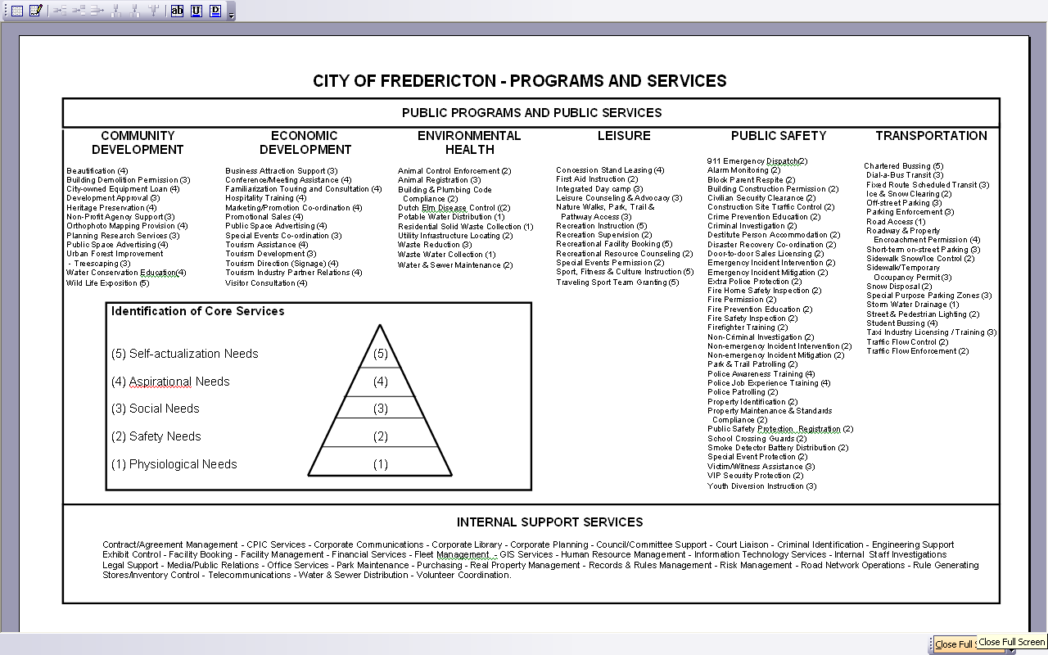
Fredericton: Applying Maslow’s Hierarchy of Needs!
Notes:
33

Slide 34
Winnipeg: Accountability and Responsibility Mapping
Audit
CAO Secretariat
City Clerks
Community Services
Corporate Finance
Corporate Services
EPC Secretariat
Fire Paramedic
Mayor's Office
Planning, Property
Police Service
Prop. Assessment
Public Works
Transit
Water & Waste
Service Names:
Animal Control,Care
Arts, Ent. &Culture
X
X
X
X
Assessment/Tax
X
X
X
Building Permits
X
Cemeteries
X
City Beautification
X
City Planning
X
Community Health
X
Council & Admin
X
X
X
X
X
X
Crime Prevention
X
X
X
Disaster Response
X
X
Econ. Development
X
X
X
X
X
Notes:
34

Slide 35
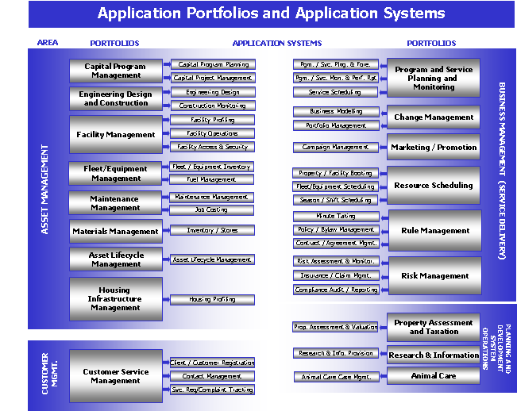
Edmonton – Departmental IT Strategic Plans
Notes:
35

Slide 36
Inter-Jurisdictional Service Mapping
Federal Information & Services
Community Information & Services
Provincial Information & Services

Slide 37
Municipal Reference Model Implementing The MRM in IBM Rational System Architect
Notes:
37

Slide 38
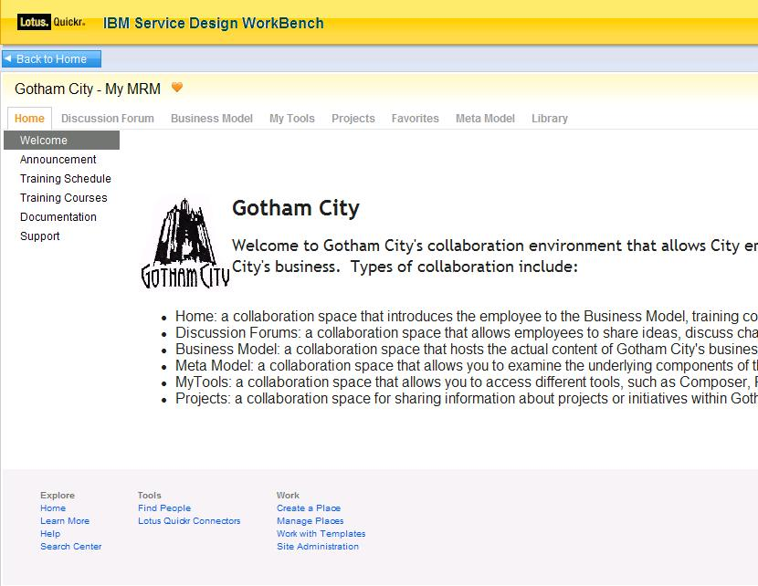
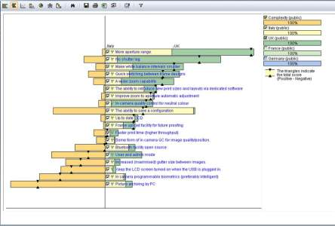
Tooling Architecture: for Municipal Strategic Planning
Business User
Business Analyst
Planner
Lotus Quickr,
SA/XT
System Architect,
RAM, RPE
Focal Point
Collaborate – forums, wikis, news, defects, enhancement, etc.
Capture, validate and reason about model content
Review business component content published from SA
Optional: Review and edit Municipal Model with SA/XT
Create & manage business components
Build relationships between components
Query business components
Compare business components in one municipality or across municipalities
Import/Export business component matrices
Elaborate on business components with documents, BPMN diagrams, UC diagrams
Compare and merge content from different analysts
Perform cost/benefit analysis
Weight user importance against factors such as cost, development times, and available resources
Build, buy, or outsource decision
Optimize program and asset operations/maintenance
Notes:
Business User Artefacts:
Login/Registration
Home, News, Reference Material, Contacts, Help pages
Discussion Forum
MRM browse, municipal model browse/update
Change Requests page
Business Analysts
MRM access and municipal model access and update
Business Model Report
Program Profile Report
Service Profile Report
SIAM Diagram
Hierarchy Diagrams
Relationship Matrices
Stakeholder-specific Browsers
Planner
Project portfolio
Strategic alignment analysis
Risks, costs, time to value,
Payback Period
Project roadmapping

Slide 39
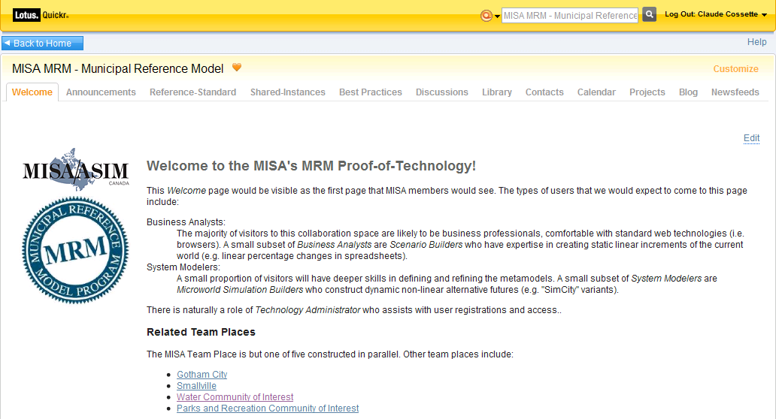
Start Collaboration from the MISA web site

Slide 40
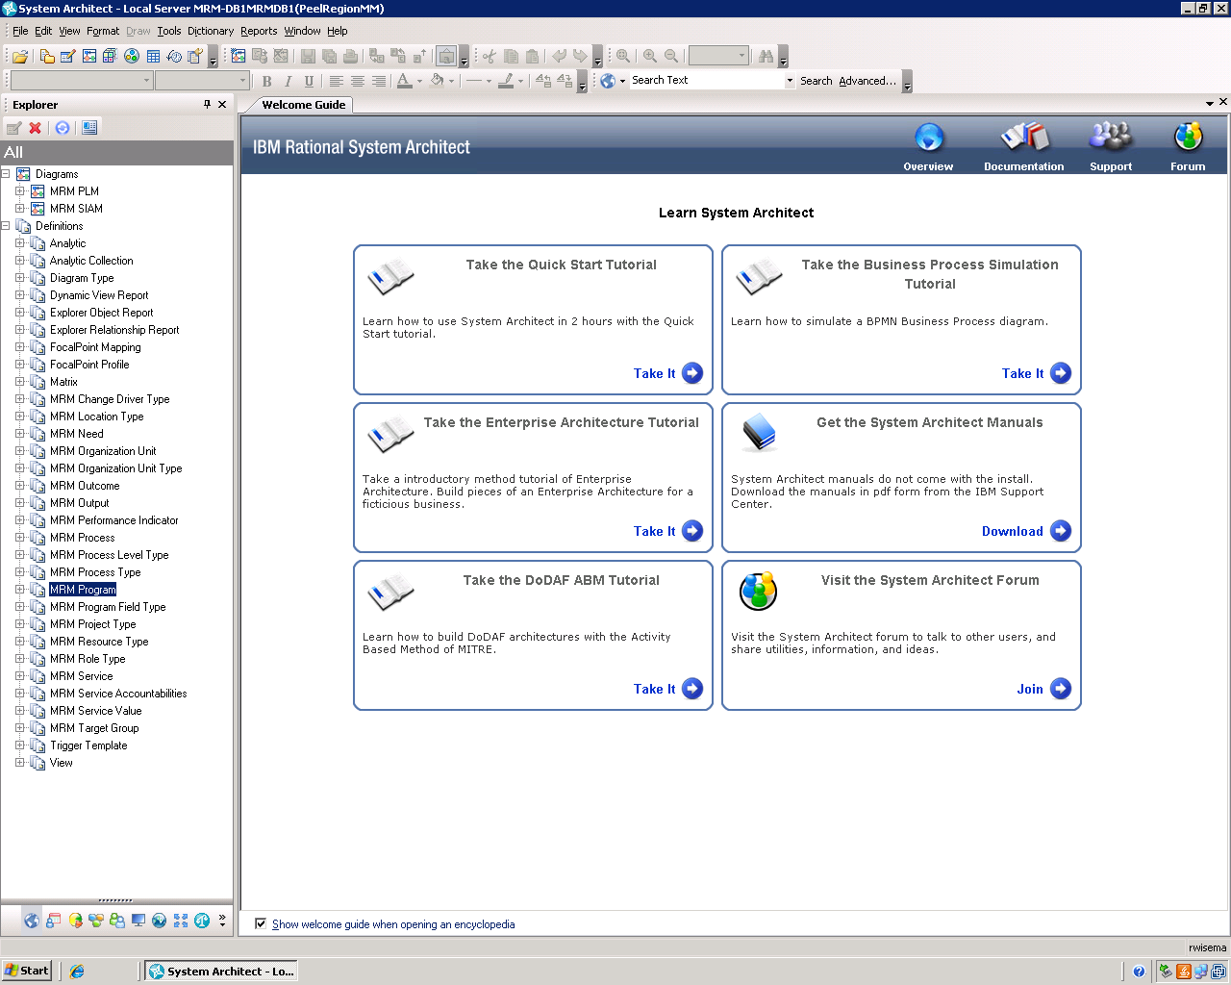
MRM in Rational System Architect: Landing Page

Slide 41
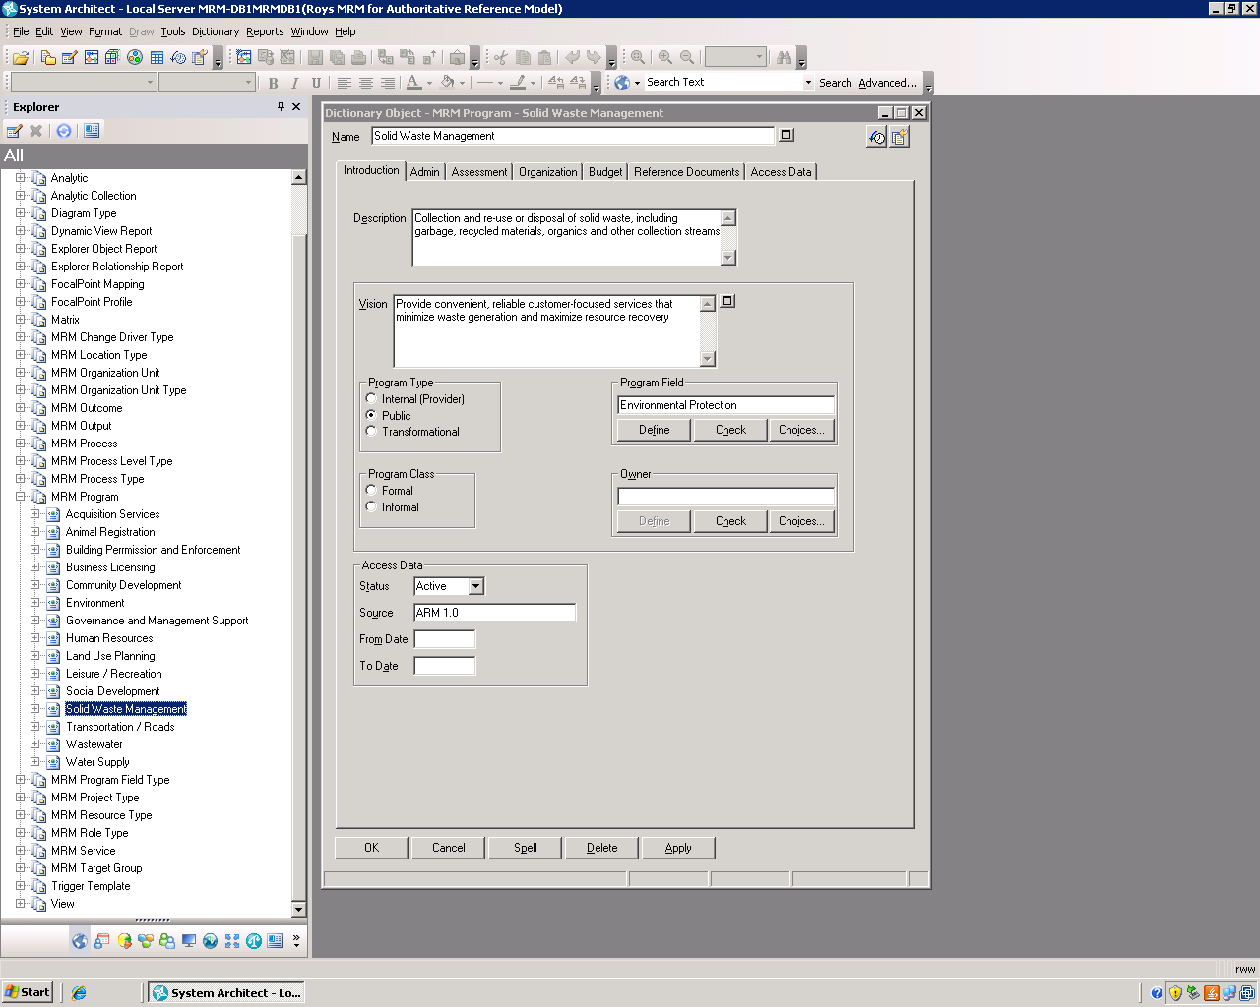
MRM in Rational System Architect: Defining a Program

Slide 42
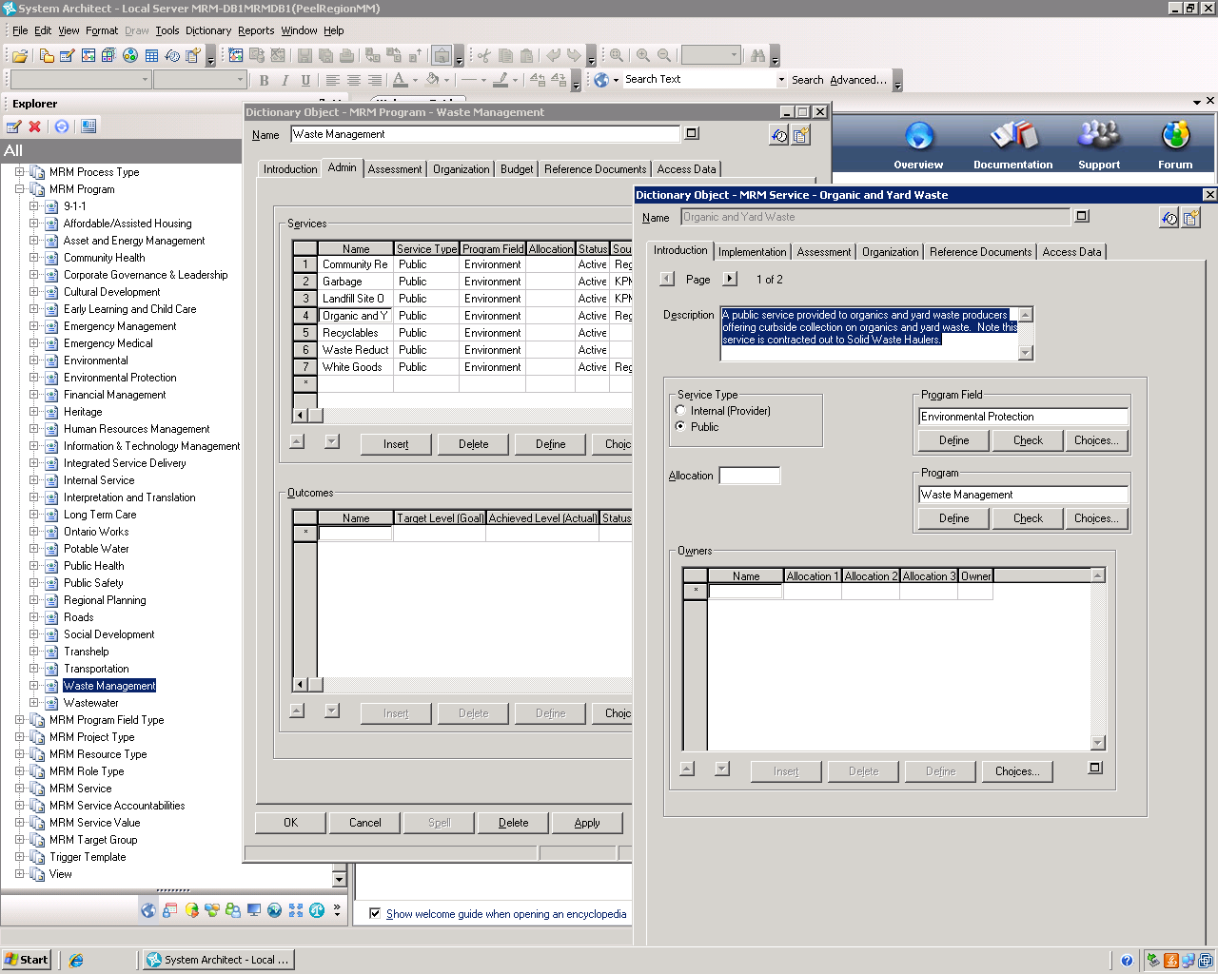
MRM in Rational System Architect: Service and Subservices

Slide 43
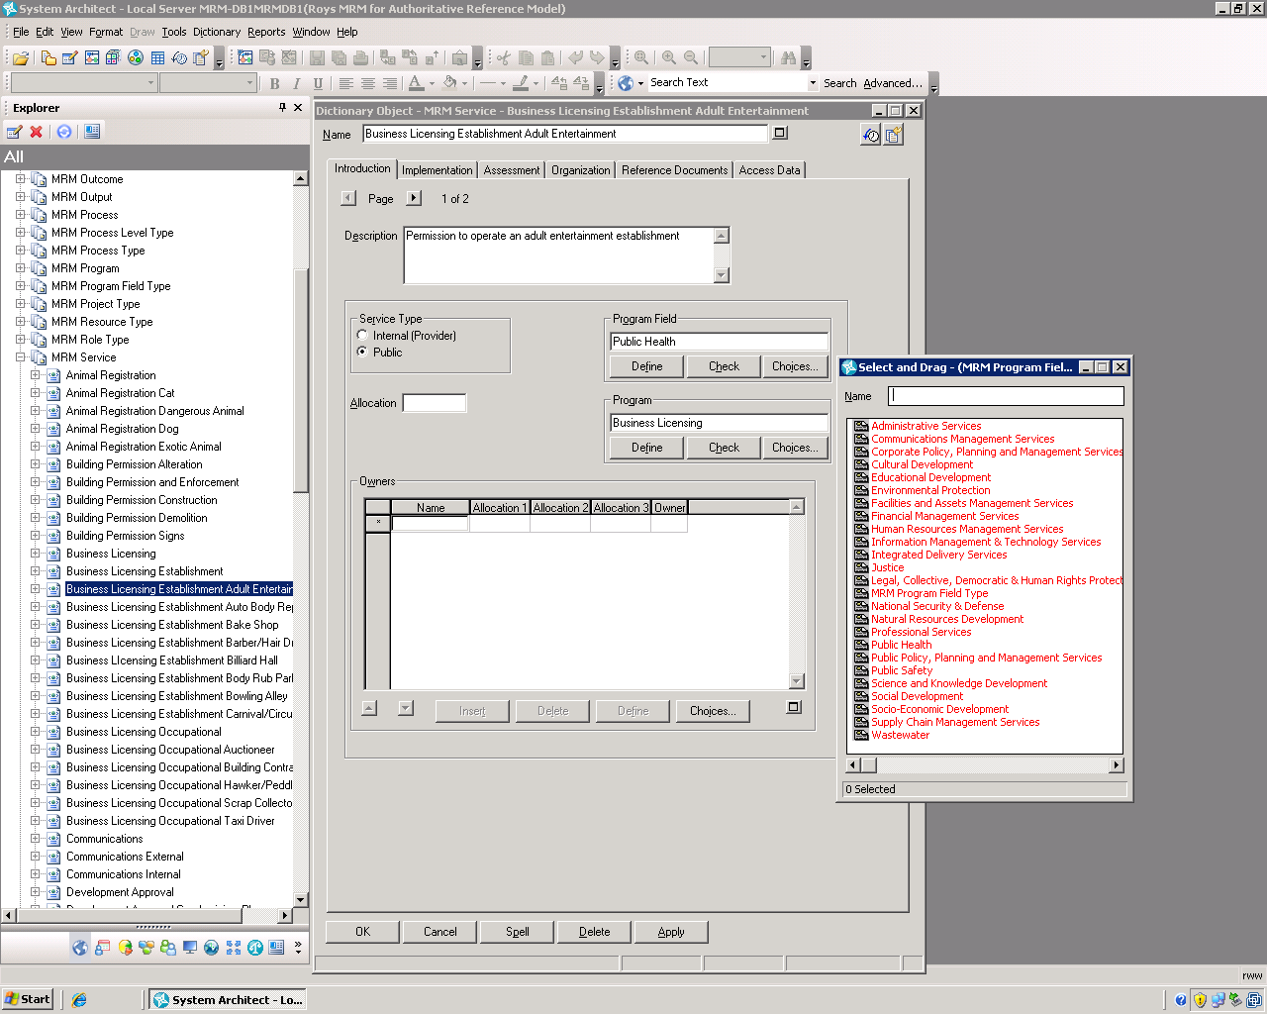
MRM in Rational System Architect: Value Lists

Slide 44
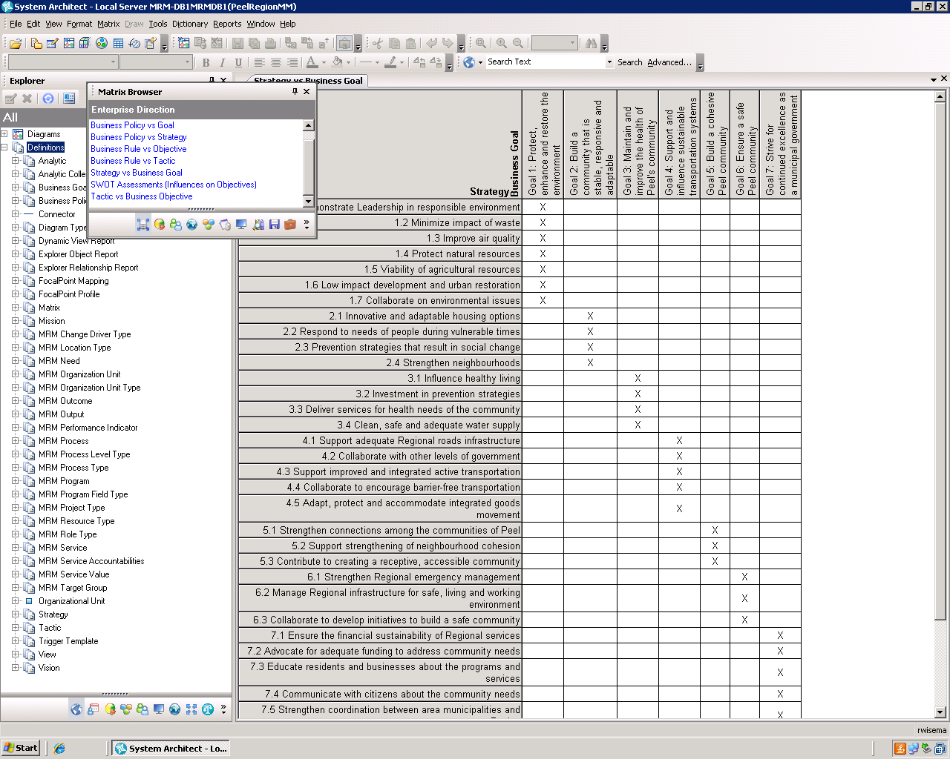
MRM in Rational System Architect: Matrix Browser

Slide 45
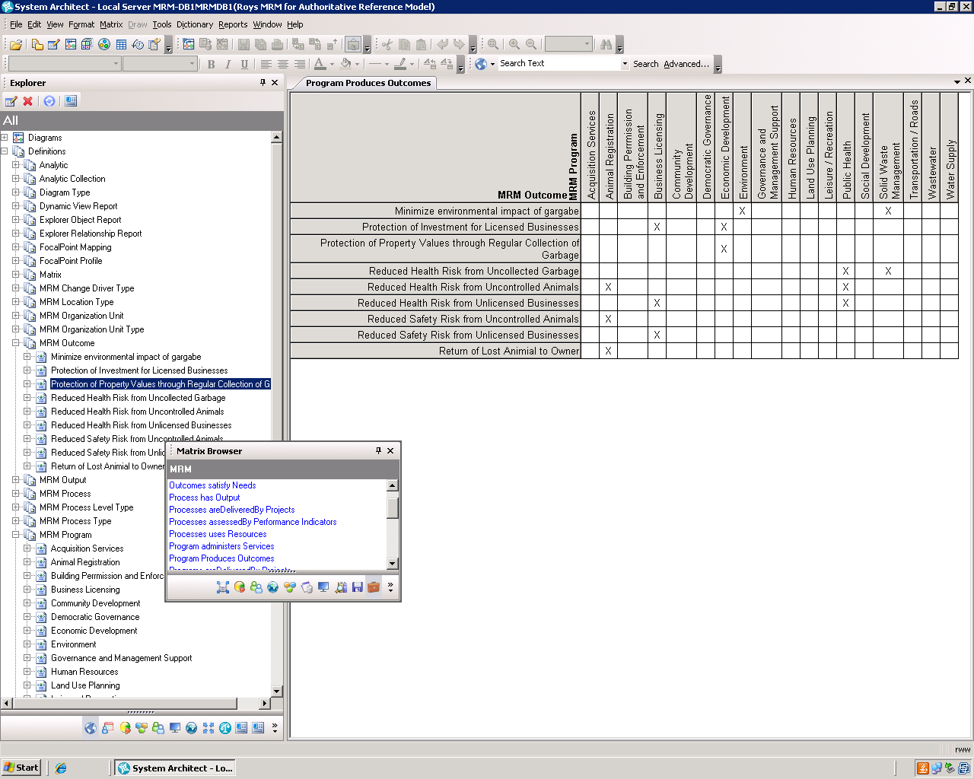
MRM in Rational System Architect: Matrix Browser

Slide 46
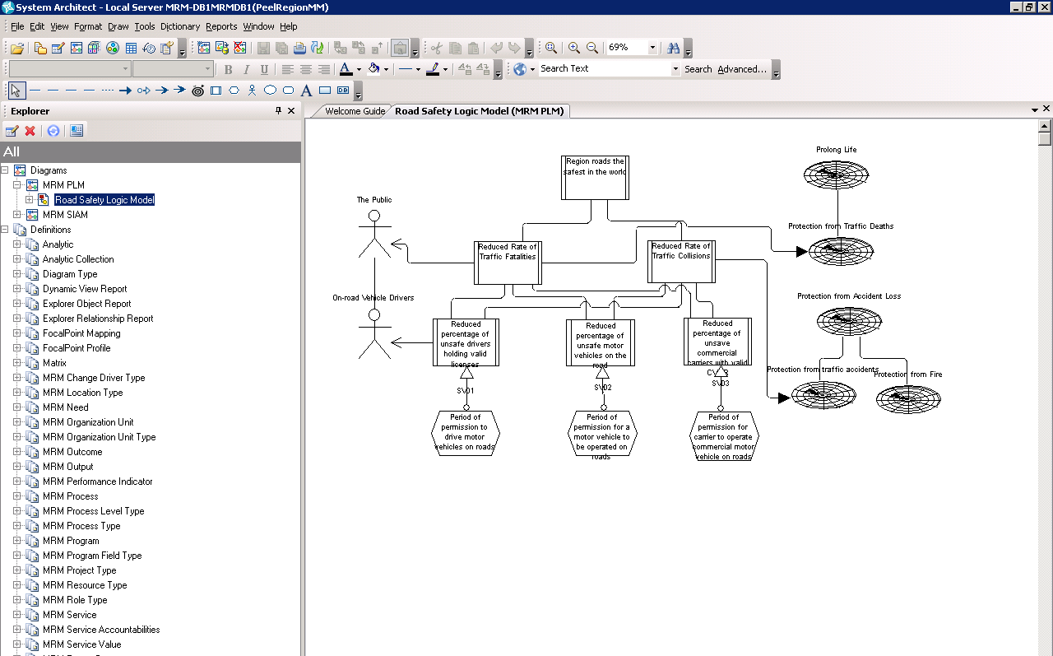
MRM in Rational System Architect: Diagramming, Logic Models

Slide 47
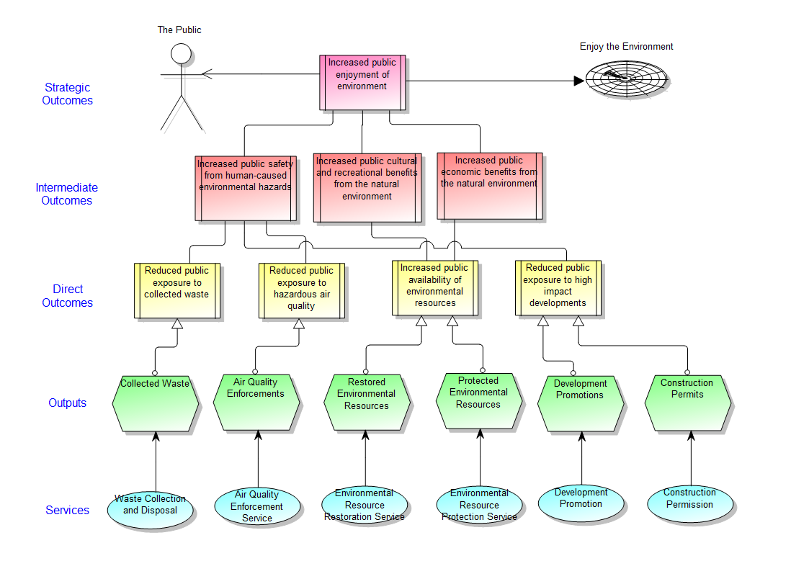
MRM in Rational System Architect: Diagramming, Logic Models
Notes:
47

Slide 48
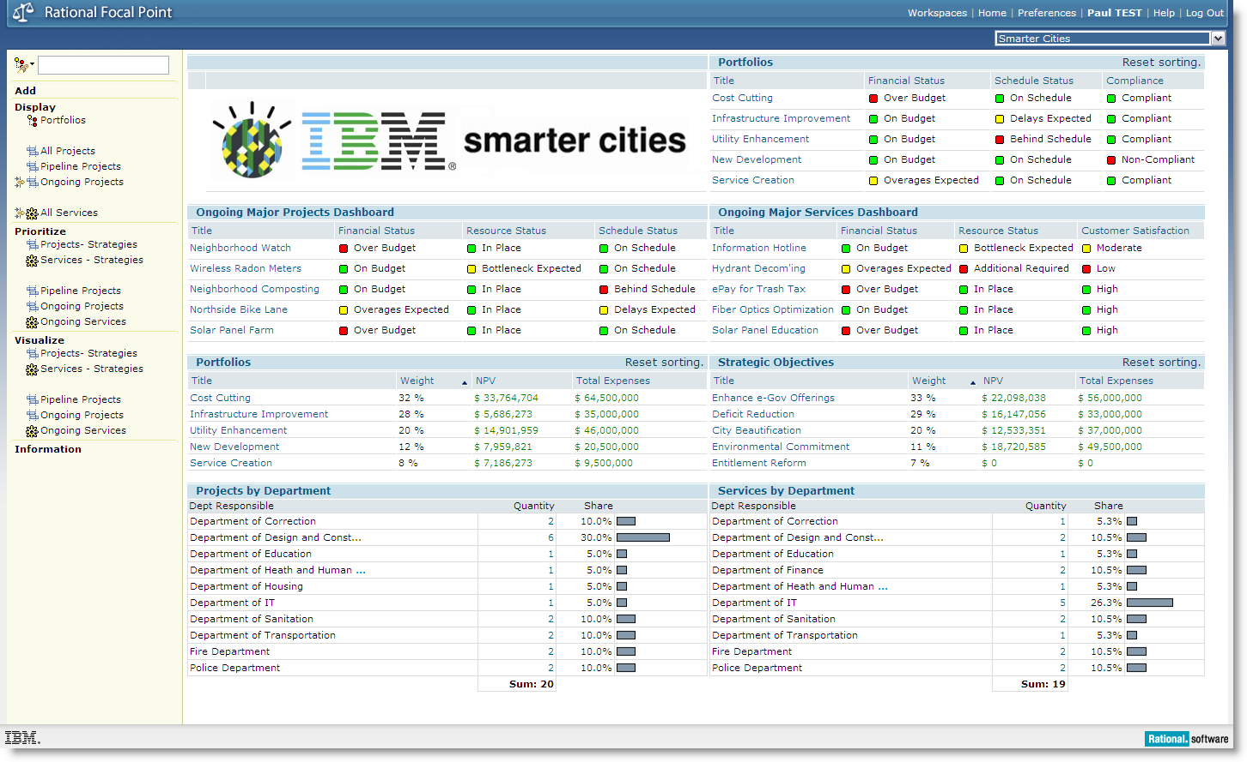
MRM Future Using Rational Focal Point: Government Accountability
Easy-to-interpret dashboards
Real-time status on budget, resources, schedule, and risks
Drill-down to detailed project information
Compare portfolio importance against budget allocations
Notes:
Focus on each capability one-at-time and demonstrate in Focal Point how each capability works.
To demonstrate how Focal Point supports government accountability I’ll display the easy-to-interpret, role-based dashboard. This includes information on portfolios, projects, and services. From here I can check the real-time status of project budgets, resources, schedules, and risks. I’ll also pinpoint a troubled project and demonstrate how I drill down to the project information to assess the severity of the budget overrun and see if the project manager has a prescription for correcting the overrun.

Slide 49
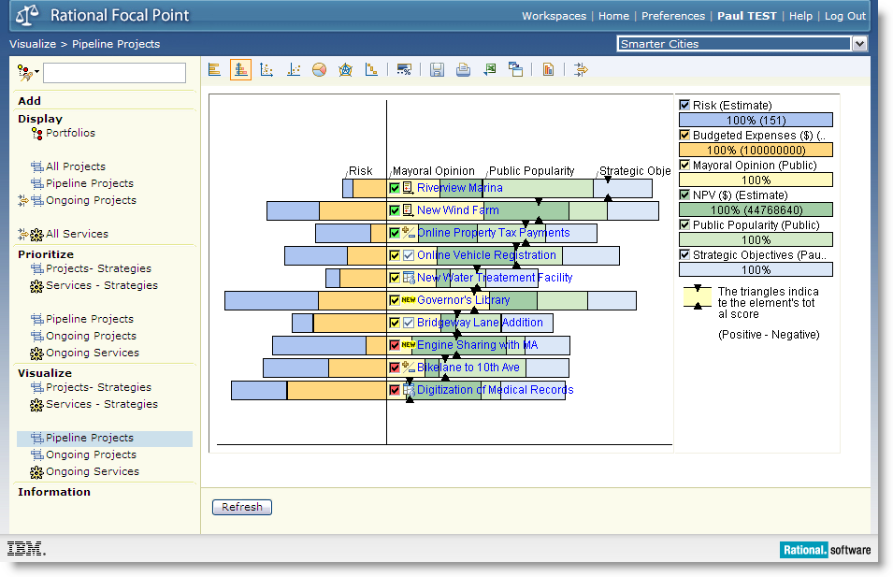
MRM Future Using Rational Focal Point: Citizen-Centered Prioritization
Visualize project value based on user-defined decision criteria
Evaluate new project requests against strategic objectives
Incorporate multiple stakeholder groups into the prioritization
Prioritize projects based on public popularity
Visualize trade-offs
Notes:
Focal Point can be used to prioritize pipeline projects and investments and rank the projects based on their aggregate value. In this example the elements in the middle of the screen are pipeline projects that have completed business cases and are now ready for prioritization. I’ve leveraged business case data into the ‘Budgeted Expenses’ and ‘NPV’ criteria located in the upper right corner. I’ve also included a number of subjective criteria such as public popularity, which can be assessed using a pair wise comparison. Using the scoring from each criterion I can make a decision about which potential projects are the best candidates for launch based on current budget constraints. From that point I can use the Gantt chart to schedule my projects based on dependencies and resource bottlenecks.

Slide 50
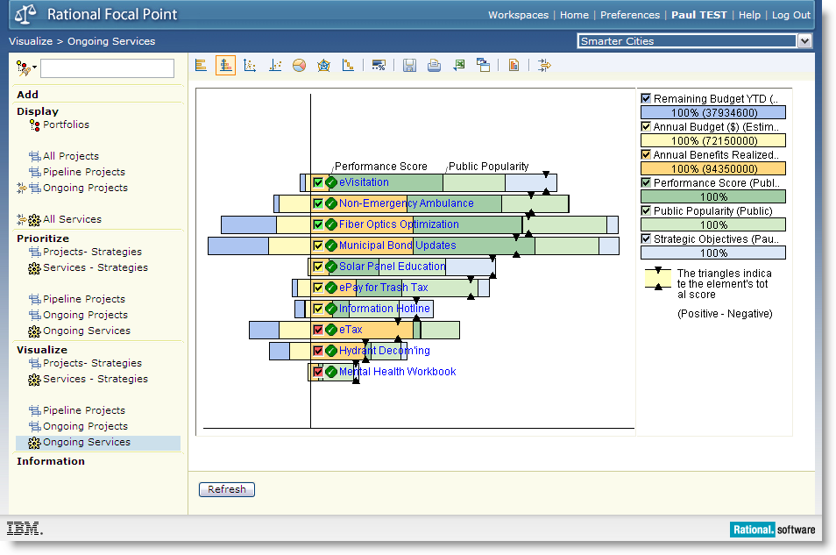
MRM Future Using Rational Focal Point: Cost-Cutting Optimization
Evaluate existing projects and services for cost-cutting targets
Visualize investments in order of value
Track scenarios that cut annual budgets and remaining budgets for the current year
Notes:
Elements in the middle of the screen are ongoing services that are being considered for termination or postponement. You’ll notice the user-generated criteria in the upper right have been customized specifically for this exercise. Using the scoring from each criterion I can make a decision about which ongoing services are the best candidates for termination based on current budget constraints.

Slide 51

www.ibm.com/software/rational
Notes:
Author Note: Optional Rational QUESTIONS slide. Available in English only.

Slide 52

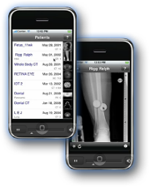

Daily iPod Touch giveaway
SPONSORED BY
Complete your session surveys online each day at a conference kiosk or on your Innovate 2011 Portal!
Each day that you complete all of that day’s session surveys, your name will be entered to win the daily IPOD touch!
On Wednesday be sure to complete your full conference evaluation to receive your free conference t-shirt!
Notes:
Daily iPod Touch giveaway sponsored by Alliance Tech
Each time you complete a session survey, your name will be entered to win the daily IPOD touch!
Complete your session surveys online each day at a conference kiosk or on your Innovate 2010 Portal!
On Wednesday be sure to complete your full conference evaluation to receive your free conference t-shirt!

Slide 53

www.ibm.com/software/rational
© Copyright IBM Corporation 2011. All rights reserved. The information contained in these materials is provided for informational purposes only, and is provided AS IS without warranty of any kind, express or implied. IBM shall not be responsible for any damages arising out of the use of, or otherwise related to, these materials. Nothing contained in these materials is intended to, nor shall have the effect of, creating any warranties or representations from IBM or its suppliers or licensors, or altering the terms and conditions of the applicable license agreement governing the use of IBM software. References in these materials to IBM products, programs, or services do not imply that they will be available in all countries in which IBM operates. Product release dates and/or capabilities referenced in these materials may change at any time at IBM’s sole discretion based on market opportunities or other factors, and are not intended to be a commitment to future product or feature availability in any way. IBM, the IBM logo, Rational, the Rational logo, Telelogic, the Telelogic logo, and other IBM products and services are trademarks of the International Business Machines Corporation, in the United States, other countries or both. Other company, product, or service names may be trademarks or service marks of others.
Notes:
Author Note: Mandatory Rational Closing Slide (includes standard legal disclaimer). Available in English only.

